Slide 1
Effects of COVID-19 and the Pandemic on Mental Health
AI Boot Camp Project 1
Team DIVOC-91 Thomas Clemons
Members: Chris Martella
Taylor Peterson
Isaac Pingel
Notes:
Thomas

Slide 2
Project Overview
Coronavirus (COVID-19) Effects on Mental Health
Our goals were to identify the effects of COVID-19, and the pandemic generally, on mental health of the U.S. Population based upon the standardized survey and reporting of the U.S. Census Bureau’s Household Pulse Survey (HPS) 2021-2023.
The intent of our analysis is to provide insight for healthcare professionals, medical institutions, and pharmaceutical companies on COVID-19 and it's effects on Anxiety, Worry, Interest Level, and Depression
Our graph and dataframe outputs provide evidence of any correlations between historical contraction of COVID-19 and frequency / intensity of Anxiety, Worry, Interest Level, and Depression.
Notes:
Thomas

Slide 3
Project Overview
Goals/Questions to be addressed
Question #1: Is there any correlation between the number of positive COVID-19 infections and anxiety / fear over the three (3) year sample period?
Question #2: What, if any, correlation exists among having COVID-19 and the feeling of worry or mailaize?
Question #3: Does having COVID-19 increase or decrease a respondent’s level of interest in everyday activities?
Question #4: Does having COVID-19 increase or decrease a respondent’s feeling of depression or hopelessness?
Notes:
Thomas

Slide 4
Project Overview
Overview of data collection, cleanup, and exploration process
Data sourced from the U.S. Census Bureau’s “Household Pulse Survey” bi-weekly survey 2020-2023.
Surveys are a collaborative effort of numerous governmental agencies (CDC, FDA, HHS, NCHS).
The HPS columns changed significantly (from 81 to over 250 questions), survey questions were removed and others added, over the many survey phases through the pandemic lifecycle.
These changes in survey questions resulted in significant cleaning and organizing of the datasets and dataframes to create uniform and consistent responses to work with.
Our cleaning and standardization of the HPS survey data focused on creating a uniform datasets and response categories over calendar quarters from 2020-2023 (most notably the removal of early 2020 responses as the Survey data and questions were in their infancy).
Notes:
Thomas

Slide 5
Project Overview
Approach taken to achieve goals
Dataset Selection and Modification
Randomized the selection of bi-weekly survey responses over annual quarters.
Imported each selected .CSV survey responses into our project repository.
Standardized / concatenated quarterly .CSV files into annual databases.
Cleaning and Refining
Analyze, identify, and clean columns to ensure consistency.
Merge similar responses by column and ensure data types are consistent (int, datetime, etc.)
Graphing and Analysis
Graphed data frames based on quarterly data results to make comparisons
Refined and regraphed based on outputs.
Conclusions
Made observations based on analysis.
Notes:
Thomas

Slide 6
Result/Conclusion 1
Anxiety and COVID-19
Is there any correlation between the number of positive COVID-19 infections and anxiety / fear over the three (3) year sample period?
Of the survey sample, regardless of COVID-19 status, those reporting having some level of anxiety are greater than those that reported no anxiety.
It appears that having COVID-19 does not materially change the percentage of those expressing some feeling of anxiety as compared to those that report not being anxious.
A larger percentage of those with COVID-19 experience anxiety than those that have not contracted COVID-19.
Notes:
Isaac

Slide 7
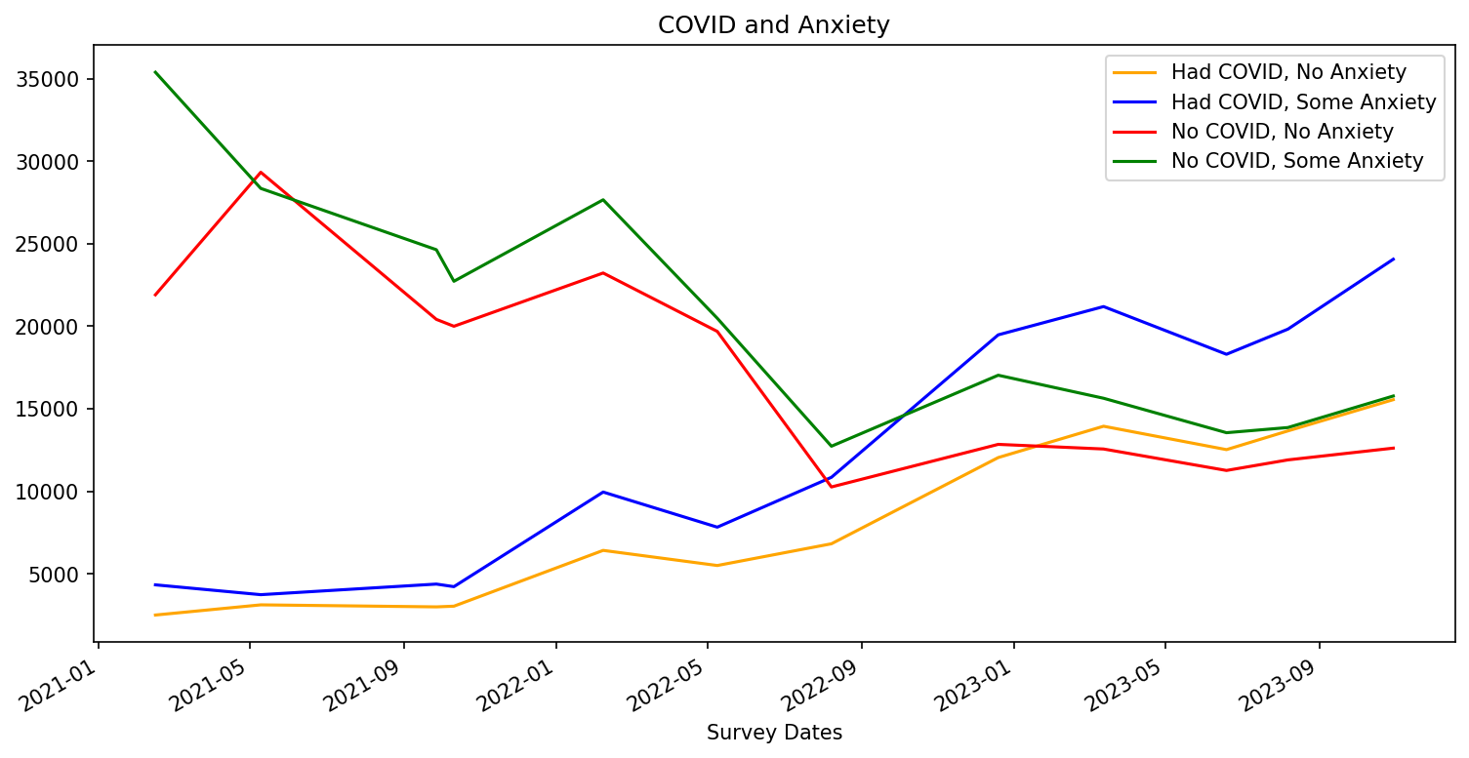
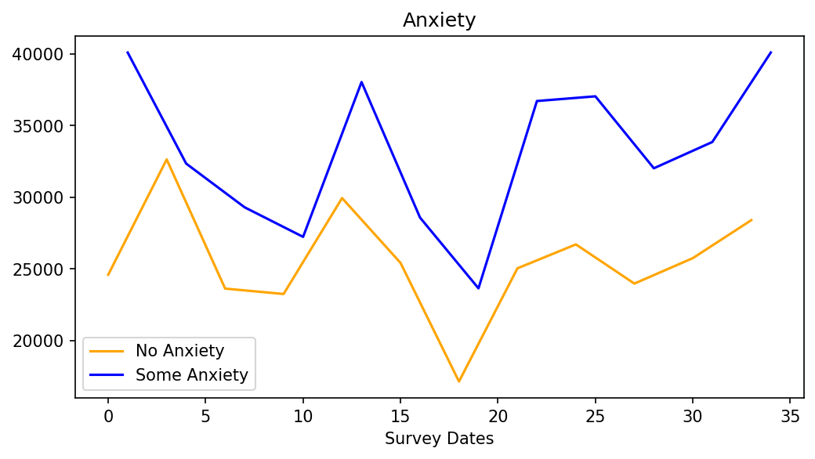
Result/Conclusion 1
Anxiety and COVID-19
Notes:
Isaac

Slide 8
Result/Conclusion 1
Result/Conclusion 2
Worry and COVID-19
What, if any, correlation exists among having COVID-19 and the feeling of worry or mailaize?
It appears that regardless of COVID-19 status, respondents not experiencing worry exceeded those experiencing worry.
Based on the visual plotting, the dataset and levels of worry, whether or not the respondent has COVID-19, are approaching the median.
Unlike anxiety, of those with COVID-19, the respondents reporting no worry sometimes exceed those experiencing some worry after the infected population increases over the non-infected population numbers.
Notes:
Isaac

Slide 9
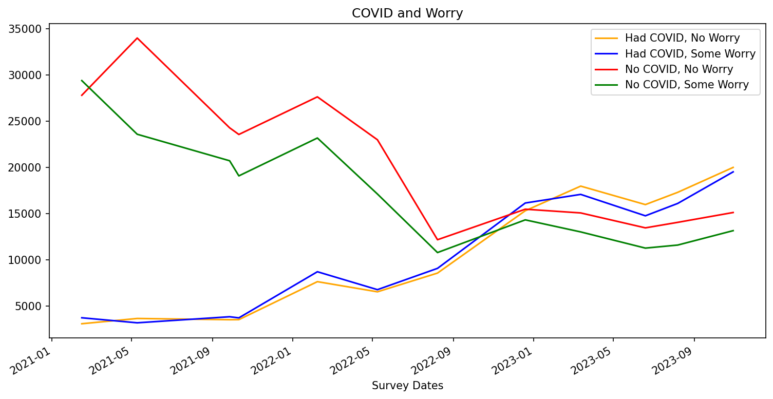
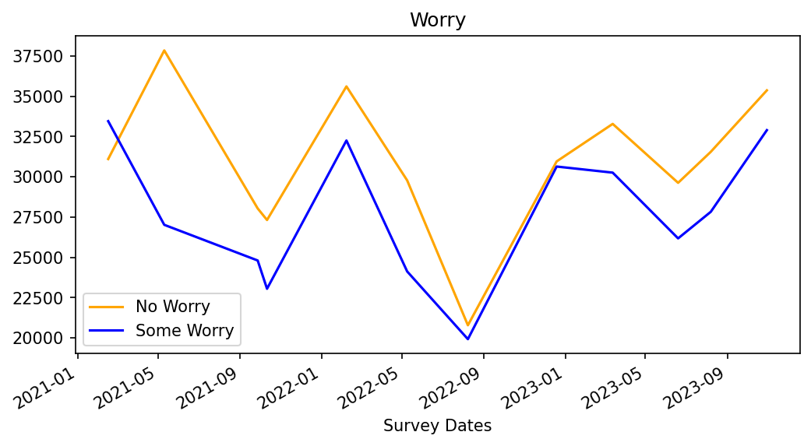
Result/Conclusion 2
Worry and COVID-19
Notes:
Isaac

Slide 10
Result/Conclusion 3
Is there any correlation between the number of positive COVID-19 infections and anxiety / fear over the three (3) year sample period?
Result/Conclusion 1
Result/Conclusion 3
Interest and Covid-19
Does having COVID-19 increase or decrease a respondent’s level of interest in everyday activities?
It appears that regardless of COVID-19 status, respondents not experiencing loss of interest exceeded those experiencing interest in doing daily activities.
Although interest is highly similar to feelings of worry in those who reported to not have COVID-19, we can see that interest levels are slowly increasing the gap between those who are not interested in daily activities, amongst COVID-19 positive respondents. Feelings of interest stay above those who experienced loss of interest, with feelings of interest increasing more during the third quarter of 2023.
Just like our graphs of anxiety and worry, we see that towards the end of 2022 and going into 2023, the responses are approaching the median as the pandemic is slowing down.
Notes:
Taylor

Slide 11
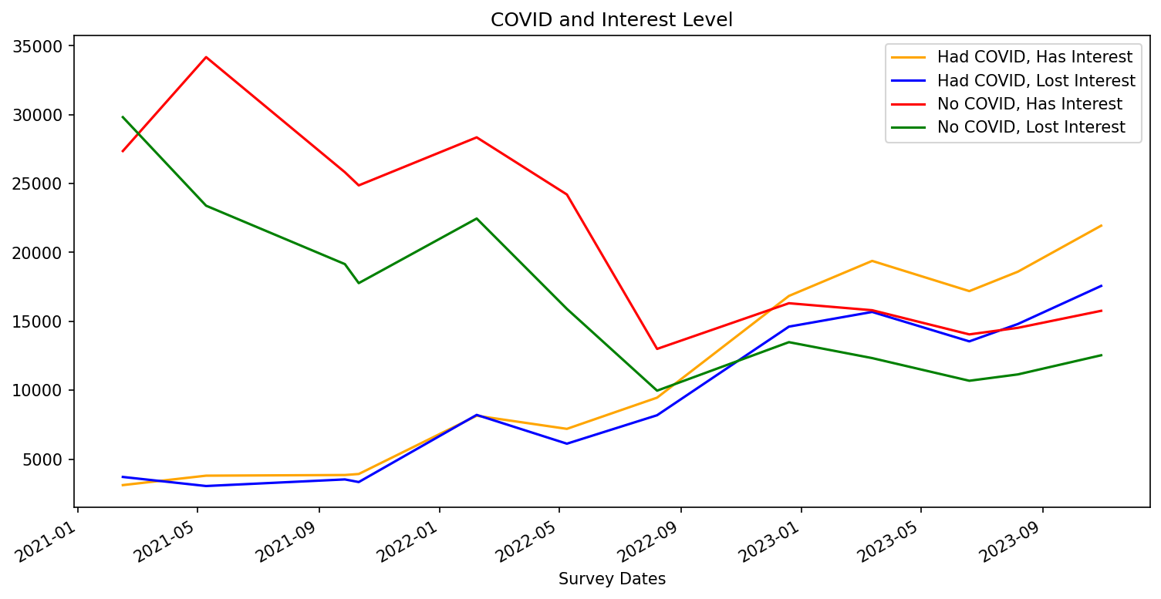
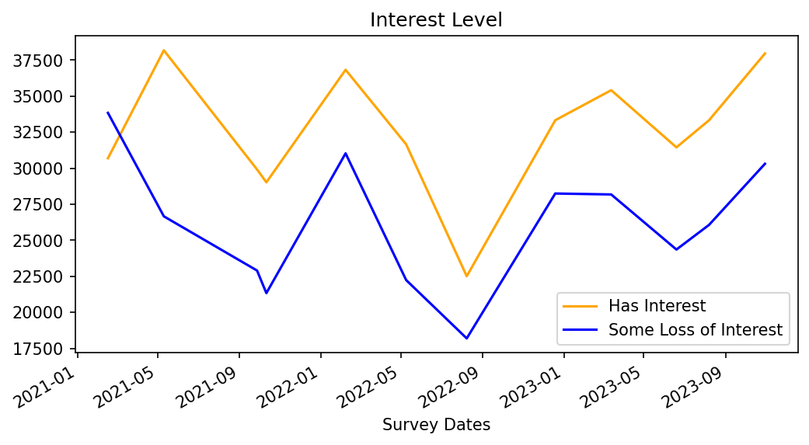
Result/Conclusion 3
Interest and Covid-19
Notes:
Taylor

Slide 12
Result/Conclusion 3
Is there any correlation between the number of positive COVID-19 infections and anxiety / fear over the three (3) year sample period?
Result/Conclusion 1
Result/Conclusion 3
Result/Conclusion 4
Depression and Covid-19
Does having COVID-19 increase or decrease a respondent’s feeling of depression or hopelessness?
Visually, it appears that COVID-19 did not increase feelings of depression to the point where they surpassed those reporting not having intense feelings of depression.
Compared to levels of anxiety experienced through COVID-19, those who experienced feelings of depression stayed below those that did not experience any feelings of depression. This was true regardless of COVID-19 status, showing no drastic correlation between the two.
It appears that of the respondents that reported a positive COVID-19 status, depression follows closely with loss of interest. In fact, their trajectories, either with or without COVID-19, are nearly identical.
Notes:
Isaac

Slide 13
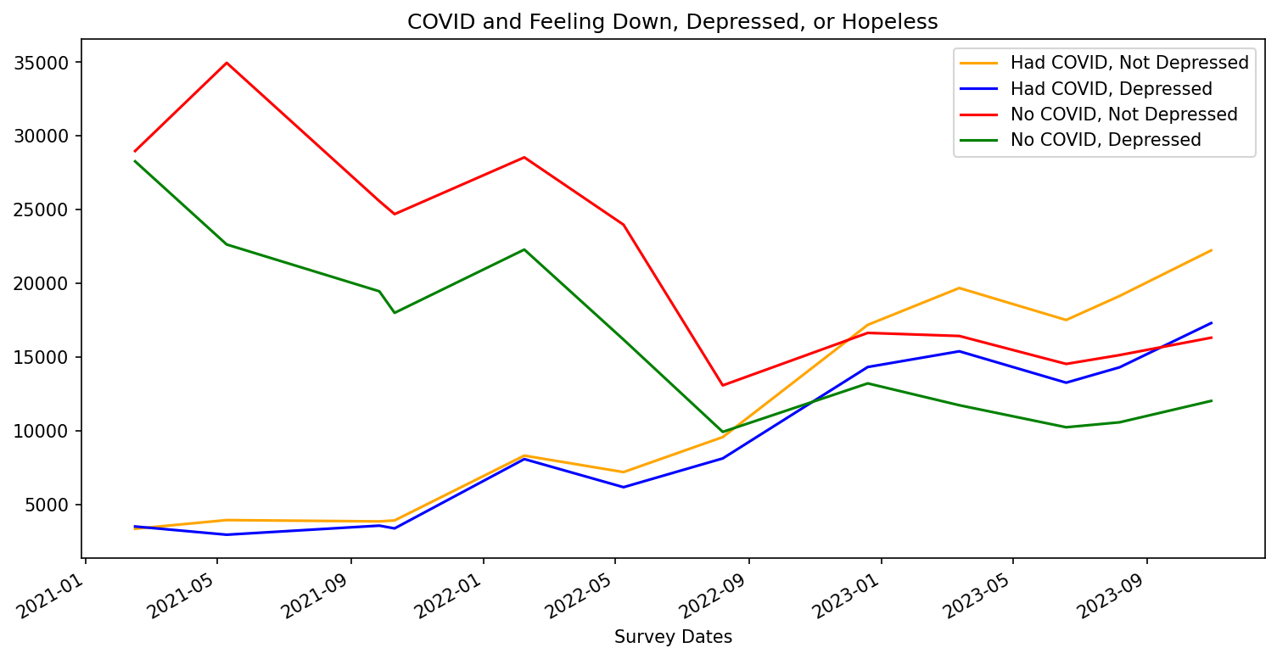
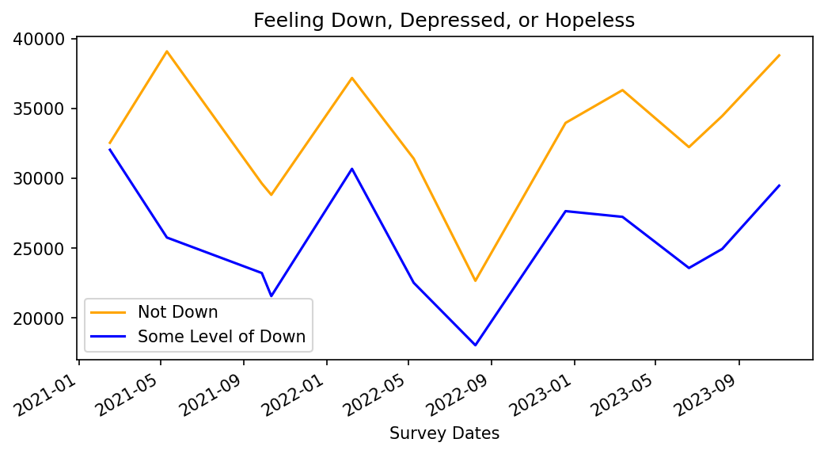
Result/Conclusion 4
Depression and Covid-19
Notes:
Taylor

Slide 14
First
There does not appear to be a correlation between COVID-19 infections and depression, anxiety, lack of interest in everyday tasks, and worsening mental health. The relationship remained constant over the survey period.
Regardless of COVID-19 Status, the resultant effect on mental health approaches a similar median value and trajectory.
Summary
Second
Feelings of anxiety is the only factor seen to have stayed above no feelings of anxiety throughout the three year period. People are generally anxious, with those having a positive COVID-19 status gradually increasing more, especially towards the end of 2023.
Notes:
Chris

Slide 15
Generally COVID-19 has been a limited time period and the Household Pulse Survey questions changed numerous times over the survey period. At least annually, the survey questions expanded or contracted without true qualification and the weighted averaging modified the raw data making analysis / categorization difficult. In addition, the responses allowed within questions varied over such survey phases.
The amount of survey participants that did not respond to individual questions or the same question over multiple surveys resulted in inconsistent and sometimes inadequate sample sizes. Additionally, the subjectivity of certain questions allowed for significant variance in responses based on the ontology and perception of the respondent.
The Household Pulse Survey contained additional categories and questions (and by correlation responses) that may be dispositive of anxiety levels, worry, interest, and depression (e.g.: job loss, employment status, food scarcity, geographical location, income, and housing status). Inclusion or plotting of such categories may provide additional insight into our analysis or findings.
Problems Encountered
Notes:
Chris

Slide 16

Future Considerations
A portion of the Household Pulse Survey included a variety of questions about children’s educational access in the home after the effects of COVID-19 (the shift to distanced learning, computer availability in the home for educational purposes, accessible internet services, and homeschooling). We focused strictly on adults for our analysis, but wIth the added stress of children and their education style drastically changing, could this result in a correlation to their mental well-being?
The Household Pulse Survey contained additional categories and questions that may be dispositive of anxiety levels, worry, interest, and depression (e.g.: job loss, employment status, food scarcity, geographical location, income, and housing status).
Stimulus payments were distributed throughout the pandemic. Would the portion of the population that received these see a boost to their mental states and a decrease in stress levels?
What other societal events affect the level of anxiety with respondents?
Notes:
Chris

Slide 17
The following reference sources were used in this project.
U.S. Census Bureau Household Pulse Survey Overview:
https://www.census.gov/programs-surveys/household-pulse-survey.html
Household Pulse Survey Dataset:
https://www.census.gov/programs-surveys/household-pulse-survey/datasets.html
U.S. Census Bureau Article on Anxiety and Frontline Health Workers during COVID-19:
https://www.census.gov/library/stories/2022/02/frontline-workers-more-likely-to-report-symptoms-of-anxiety-depressive-disorder.html
Analyze Survey Data with Python for Beginners (reference video):
https://www.youtube.com/watch?v=B-lliwc0ZMk
Link to repository: https://github.com/crmartella/DIVOC-91
References
Notes:
Chris

